Slide 1
Food & Beverage Management
Food and Beverage Marketing

Slide 2
Marketing Overview
Seeing the business from the guest perspective
Obstacles and management concerns include:
Costs
Someone might not like it
Owner likes & dislikes
Emphasizes Guest Satisfaction
If you don’t give your guests/clients what they want – someone else will!!!!

Slide 3
Guest Satisfaction
Focus on what is best for the guest
Emphasizes service
Implements guest friendly systems & Technologies
Lead high service levels by example
Market service to the guest
Rewards employees for high levels of service
Measures and communicates results
Moments of Truth – when a guest has the opportunity to form an opinion about the operation

Slide 4
3 Steps to Service Excellence
Recognize that service is important
Develop guest friendly processes that deliver to established organizational goals
Assess, respond, and re –do
The circle of Management

Slide 5
Feasibility Studies
Should be conducted before building, purchasing or re-branding an operation
Typically conducted by a third party and will include:
Identifying market characteristics
Evaluation of the site
Analysis of the competition
Estimating demand
Projecting Operating results

Slide 6
Site Evaluation
Location, Location, Location
Even the best will fail in the wrong location
Parking, traffic flow, other attractions, type of neighborhood, competition are all factors

Slide 7
Marketing Research
Typically consists of:
Property/Site Analysis
Competition Analysis
Market Analysis
All together these represent a Situation Analysis and answer SWOT questions
(Strengths, Opportunities, Weaknesses, Threats)

Slide 8
Market Characteristics
Include:
Age
Gender
Income
Marital status
Education
Retail sales
Area Businesses & Competition
Area Demand Generators (i.e. arena)
Direction of the local area economy (up or down)
Today’s technologies simplify this data gathering

Slide 9
Estimating Demand
Uses surveys
Business research
Third party research firms and data collection using computer surveys are helpful
Demand Generators -------

Slide 10
Demand Generators
Demand Generators are people, places and events that will supply you business with customers
People – Office buildings, University Campuses, Entertainment complexes, Courthouses.
Events – NCAA playoffs, Superbowl XXIVXYZ, Golf Tournaments
Places – Stadiums, Convention Centers, Arenas, Theatres, etc.

Slide 11
Projecting Operating Results
Most studies provide pro forma results extending up to 3 years
Potential investors use the operating results to evaluate if other planned expenses are in line
Administration
Labor
Marketing
Maintenance
Insurance
Taxes
Feasibility Studies must be current when used!!!

Slide 12
Market Analysis
A Market is a group of guests with similar needs, wants, backgrounds and buying habits.
Not exclusive to demographics
Positions the operation in the market
Identifies Marketplace factors and trends
Guest profile research –
Who is eating?
Comment cards
Guest surveys
Special Promotions

Slide 13
Competition
Establish how the new operation will position itself in the market and determine:
Type and volume of demand
How well the competition satisfies the consumer
Strengths and limitations of the competition
The points of differentiation that must be established
Can aid design of building, menu and service style

Slide 14
Competition
“It is said that if you know your enemies and know yourself, you will not be imperiled in a hundred battles; if you do not know your enemies but do know yourself, you will win one and lose one; if you do not know your enemies nor yourself, you will be imperiled in every single battle.”
Sun Tzu, The Art of War – 6th Century BC

Slide 15
Competition
Assesses every possible competitor –
Will include:
Location and how long in business
Type of restaurant
Source and volume of business at all meal periods
Days and hours of operation
Menu & menu prices
Check Average
Service style
Seats
Beverage service
Entertainment
Promotional efforts
Chain affiliation
Restaurant reviews – guest satisfaction

Slide 16
Competition Analysis
Name: Al’s Italia
Location: 100 West Central Blvd (Orange Ave & Central)
Established: 1967
Sources of Business & Volumes:
M-F Lunch High Volume 11:30 – 2:00 pm – Typically Business People
M- F Dinner – busy 5:30 – 7:00 – Strong take out, Families
Hours of Operation: Monday – Friday (11:00 am – 9:00 pm)
Saturday – Sunday (closed)
Menu Style: Heavy on pastas and salads, traditional American Italian. Excellent Dessert menu
Average Check: Estimated at $16.95.
Service Style: Table Service
Seats: 75
Beverages: Beer and Wine only
Entertainment: Accordion player on Fridays
Promotional efforts: “Bakers dozen” dessert,
Chain Affiliation: None
Reviews: Generally good – Scott Joseph “FLOG”, Yelp 4 stars, Urban Spoon 4 ½.
Website: www.Alsoldtimefood.com

Slide 17
Competition Analysis
Competitor: _______Al’s Italia________________________________
Overview:
Al’s Italia was established in 1967 by the Carducci family. The restaurant has been a local favorite for many years and by it’s location next to the courthouse does a very strong lunch and early dinner business. The menu is very traditional 1970’s & 80”s Italian American cuisine, heavy on cream sauces and pastas. The restaurant is closed on weekends.
The décor features banquet style chairs with glass tops over white tablecloths. There are Chianti Bottles with candles and Italian Tourist posters on the walls. They offer live accordion music on Fridays.
Strengths Opportunity
Established in Market Offer new fusion style cuisine
Famous for desserts and breads Offer Delivery option
Located next to courthouse Develop Catering plan
Familiar menu Validate Parking
Live Entertainment
Weaknesses Threats
Not Innovative – menu does not change Other restaurants targeting same area
Limited Service Hours /days Many restaurants failed in area
Lack of parking or validation New chef at restaurant
Entertainment not offered for families Many moving away from Italian food for health reasons
Dated interior

Slide 18
Competition Analysis
Should cover Direct competition
Managers should actually experience the competition’s food and beverage experience
Try at peak and slow times to completely understand the operation
Watch and possibly recruit the best employees

Slide 19
Property Analysis
Written and unbiased assessment of the operation production and service areas
Interior appeal as well as “curb” appeal
Think about the facility from the guest perspective

Slide 20
The Marketing Plan
Translates the market research onto a set of actionable strategies that are measureable.
Target Markets
Determining Objectives
Creating Action Plans
Monitoring implementation
Measures Results
And ……………..?

Slide 21
Marketing Plan
Select Target Market
Determine Objective
Create Action Plan
Evaluate Results
Revise

Slide 22
Components of the Marketing Plan
Target Market
General Demand Generators
Competition
Analysis of Competition vs. your Concept (SWOT) analysis
Action Plans to support Marketing Efforts, should be measureable

Slide 23
Action Plan
Should be in Writing
Understandable
Realistic – yet challenging
Specific, measurable, actively monitored
Expenses should be included as well as who is responsible

Slide 24
Action Plans
Action Plans should include costs where applicable
Notes:
Why would you host a client appreciation party after the holidays are over?

Slide 25
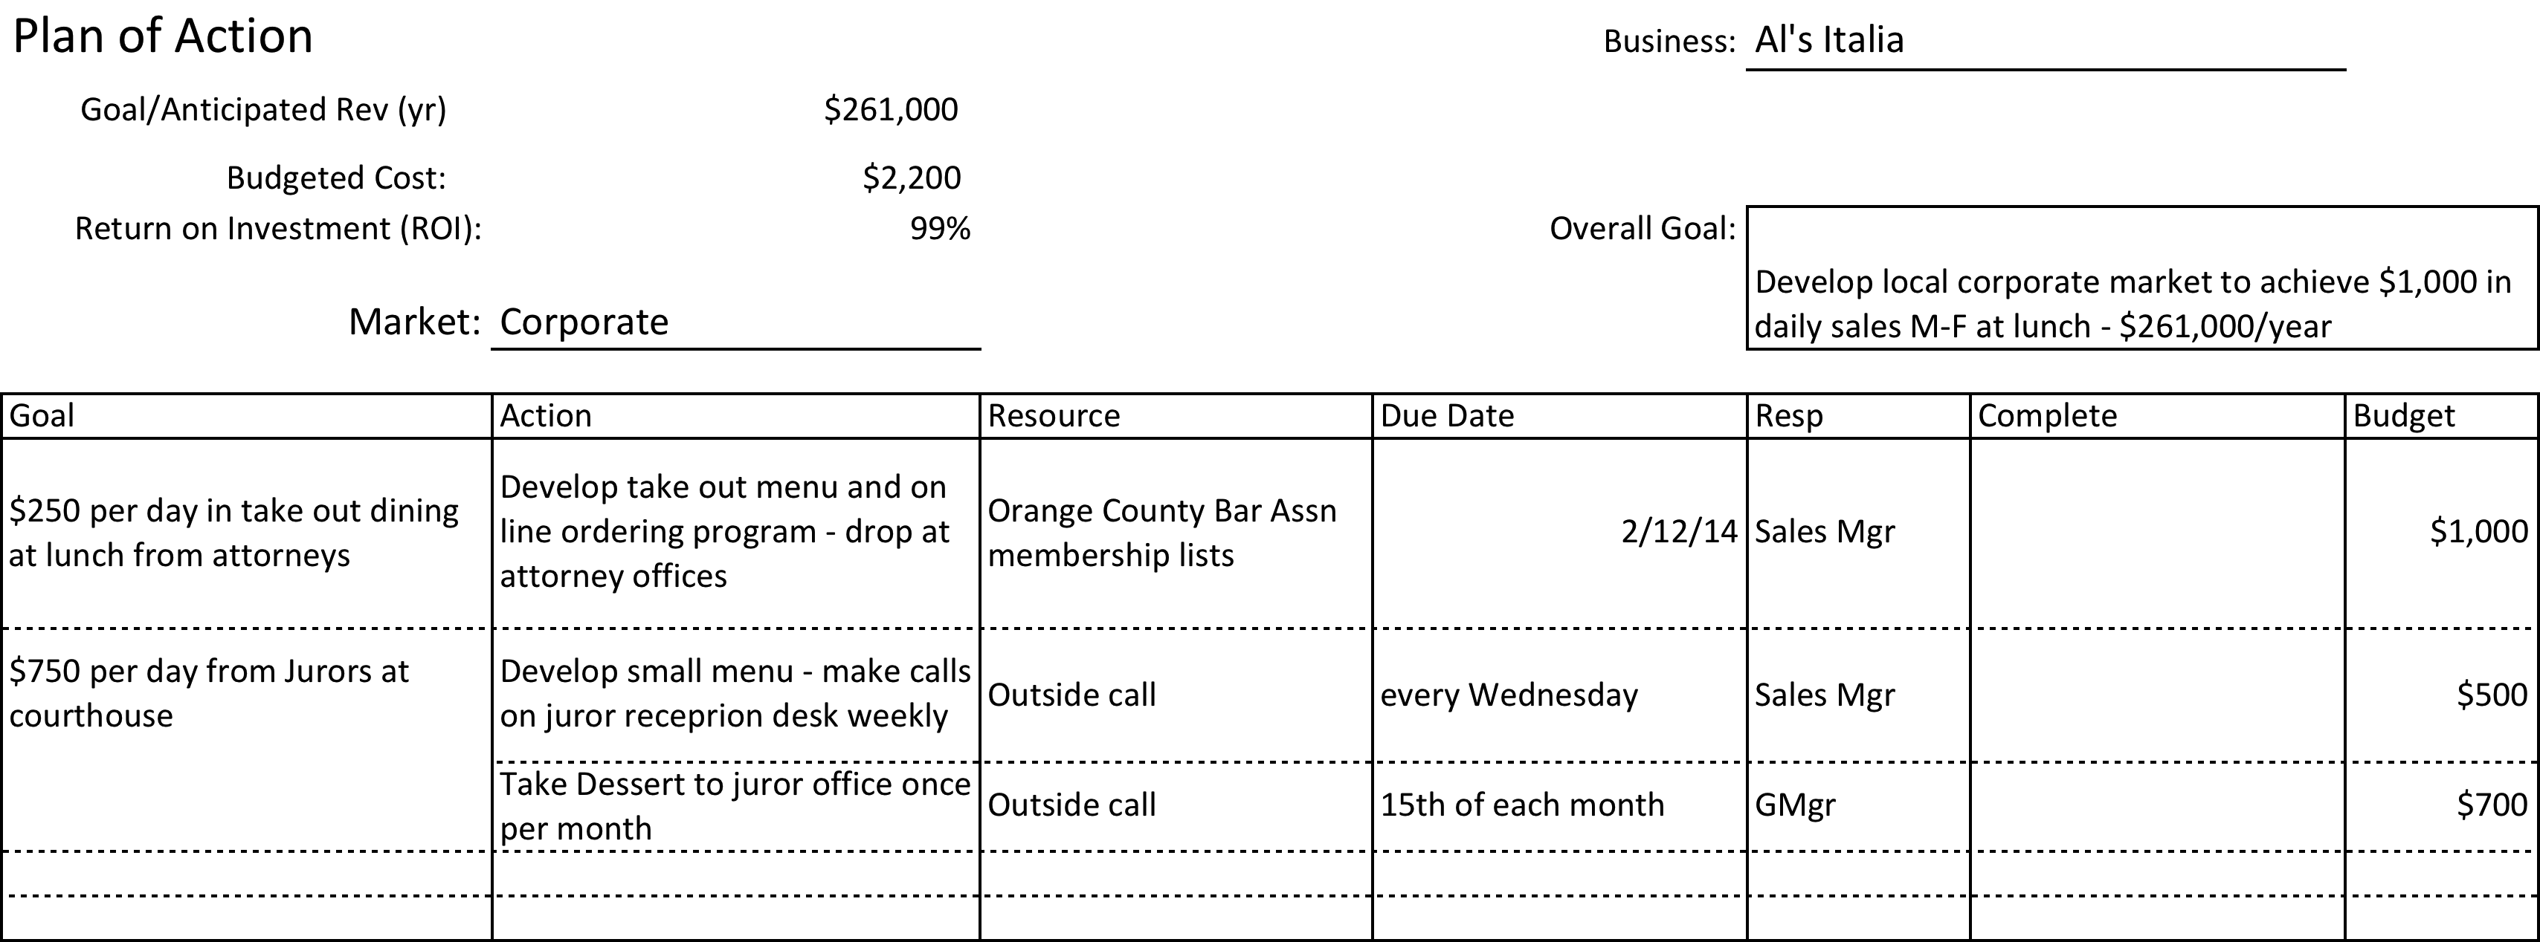

Slide 26
Implementation
Sales Efforts
Internal
Suggestive Selling
Increases revenues from existing patrons
External
Catering
Non Commercial

Slide 27
Internal Merchandising
Types of Internal Merchandising
Coupons
Sampling
Packages
Premiums
Gift Cards
Discounts
Bonus Offers
Loyalty Programs

Slide 28
Advertising
Outdoor Advertising
Advantages
Low Cost
Long Life span
Broad Reach
Disadvantages
Limited Message Length
Waste Coverage
Zoning Laws

Slide 29
Advertising
Newspapers
Advantages
Target readership by zip code
Target readers by section (Business, Comics)
Can be placed quickly
Easy to cancel or repeat
Discounts per column inch
Disadvantages
People skim
Glance at ads
Throw away coupons
Paper quality

Slide 30
Advertising
Magazines – there is a magazine for everything!
Advantages
Lasts a week or a month
Broad distribution – same ad may be seen by many
Targeted Market
High print quality
Disadvantages
Much higher production costs
Deadlines well in advance of distribution

Slide 31
Advertising
Radio
Advantages
Saturate an entire area
Cost little to produce
Pricing Options based on programming
Targeted to geographic area
High frequency of message distribution
Disadvantages
Extremely short life span (use for special events)
Lack of visual presentation invites “tune out”

Slide 32
Advertising
Television
Advantages
Target Markets based on programming
Extensive Coverage
Combines sight and sound
High frequency of message distribution
Disadvantages
High Production costs
Months of lead time
Air time very expensive

Slide 33
Direct Mail
General Rules –
Make sure you have a qualified list
Make the piece focused and actionable
Maintain the database
Make it what the guest will be interested in –
Best lists are those you develop yourself.
Lists can be purchased, but you get what you pay for.
Notes:
Next section is telephone books - seriously

Slide 34
Direct Mail
Advantages
Audience Selectivity
Great flexibility
Can be personalized
Start and stopped quickly
Can be measured with “bounce backs”
Disadvantages
High quality can be expensive
“Junk” mail image

Slide 35
Other tactics
In room menus at limited service hotels
Airplane Banners
Ads in event programs
Charitable Mentions
Name Placement on Sponsorships
Telephone book display
Bathroom walls
Specialty advertising
Signage on vehicles
Community bulletin boards
Word of Mouth (good and bad!)

Slide 36
E Commerce
Websites
Show menus
Add video
Specials
Blogs
Web Advertising
Click Through banner ads
Social Media
Mobile Devices
Facebook
Twitter
Instagram
Yelp
Other
Blogs

Slide 37
Public Relations
Communicating Favorable information about the operation to the public, develop publicity.
Satisfied Guests
Charity
Community Involvement
Cooking Demonstrations
Cooking Competitions
Uncontrolled – Restaurant Critics and related “FLOGS”, Dining Guides

Slide 38
- Concept & Marketing Due 2/24/2014
Describe your Food and Beverage business concept
1. Business name and hours of operation
2. Vision Statement
3. Mission Statement
4. Marketing Plan
Assumption – the market will be downtown Orlando from South Street, north to Robinson St, and from the Orlando Arena east to S. Rosalind Ave.
Should include:
Target Market
General Demand Generators - today and tomorrow for the downtown Orlando Area (not necessarily just the geographic boundaries of the market area
Competition (minimum of 4)
Analysis of Competition vs. your Concept (SWOT) analysis
Action Plans to support Marketing Efforts, should be measureable

